Slide 1
Asians in Austin
A Data Analysis of Quality-of-Life Indicators Amongst Asian-Americans in Austin, Texas

Slide 2
Can We Predict Quality of Life for Asian-Americans?
Dataset: From https://data.austintexas.gov/, published June 2018 (collected in 2016 or earlier)
Sample: 2,607 residents of Austin, Texas identifying as Asian-American (Filipino-American, Japanese-American, etc.)
Data Collection: Voluntary submission of paper survey containing about 200 questions

Slide 3
Data Wrangling and Pre-processing
Categorical and Binary Variables
“Do you participate in…”
“Yes/No”
“I live with my grandparents/0”
“1/No”
Scored Variables
“Please rate your access to healthcare”
Poor/Fair/Good/Very Good
Extremely Dissatisfied / Very Satisfied
Solution
Iterate through features to identify response type
Score the subsequent response
Manually review results
Unresolved Sources of Error
How to score subjective assessments
Self-reported metrics, including target variable

Slide 4
Exploratory Data Analysis for High-Feature Dataset
Check for data distributions, value counts, and NaNs
Impute categorical features to “0”
Impute numerical features to mean/median
Don’t bother comparing features in a high-feature dataset
Use Pandas Profiling!
Assign dummy variables → uniform binary- and categorical features
Principal Component Analysis → consider using as as a hyperparameter
Processed data shape: 2,607 observations of 247 features

Slide 5
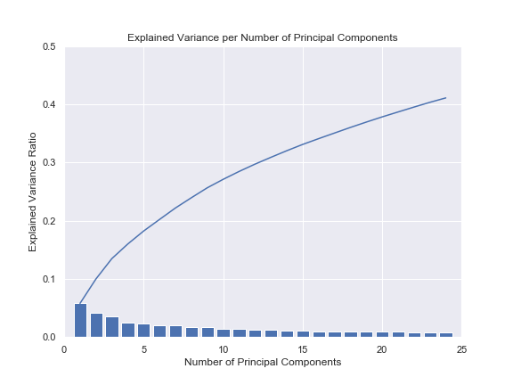
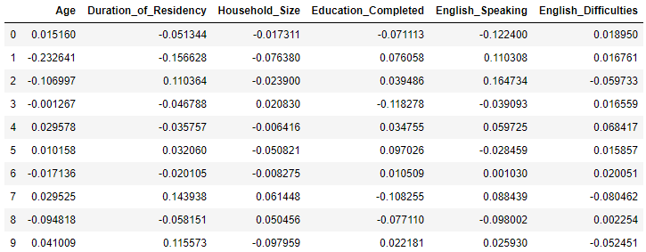
How about Principal Component Analysis?
Coefficients of Key Variables in PCA

Slide 6
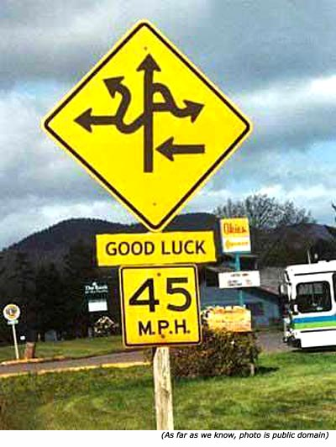
Observations from Pre-Processing
Limiting Factors
Self-reported data
Conceptual questions
Non-standardized responses
Complex value systems
Solutions
Limit, don’t eliminate error
Acknowledge the dataset’s diversity
Token Analysis

Slide 7


Model Selection
Questions
Which Model?
Which tuning method?
Which hyperparameters?
Obstacles
CPU Time
Accuracy
Solution:

Slide 8
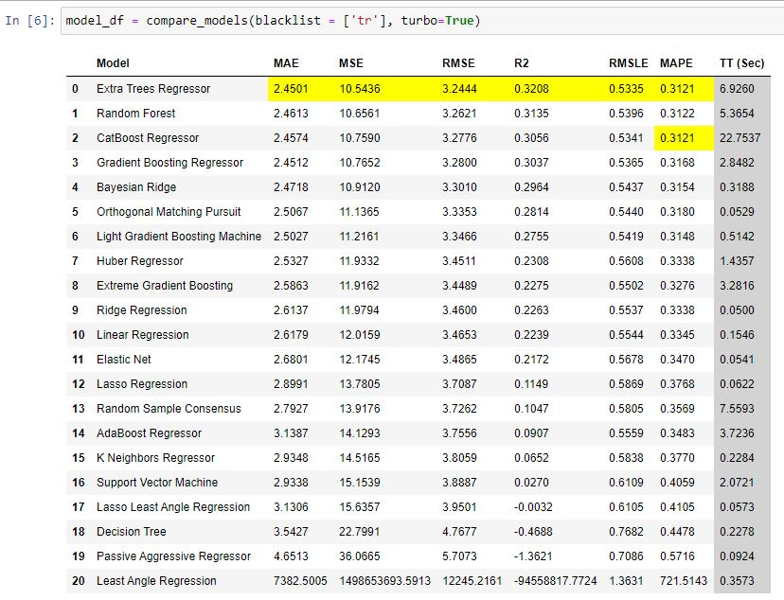

Slide 9
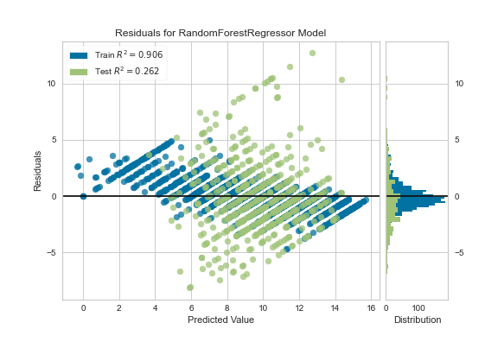

Slide 10
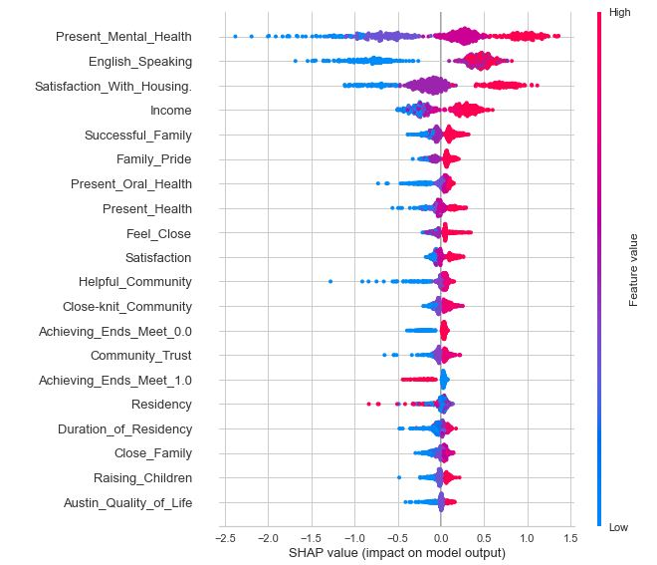
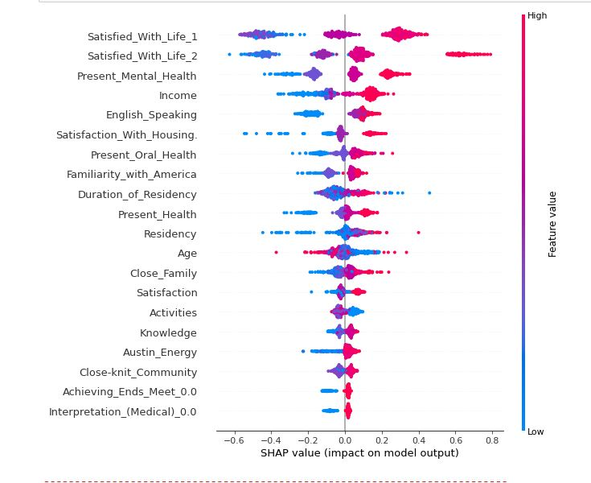
Target Identification
Target 1: “Satisfaction Score”
(Quality of Life + 2 responses about Satisfaction)
Target 2: Quality of Life

Slide 11
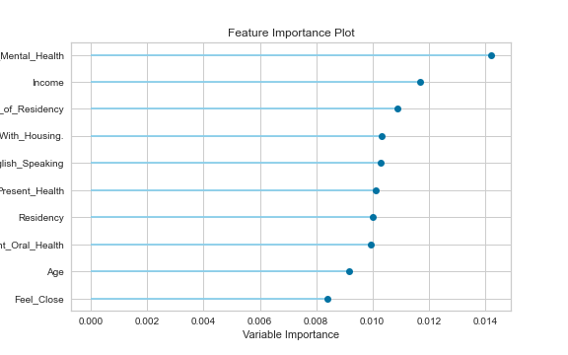
Token Analysis

Slide 12
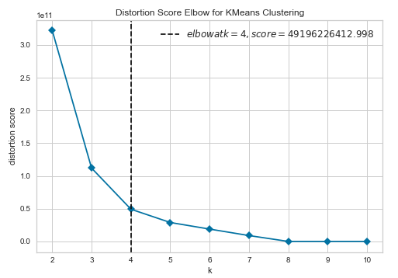
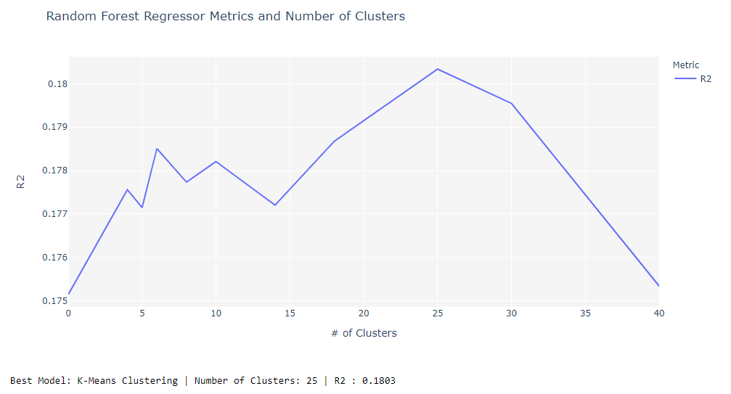
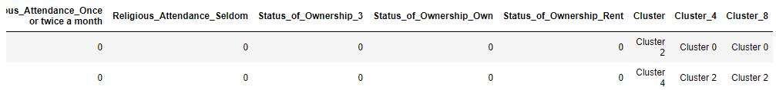
Further Study - Cluster Analysis

Slide 13
Conclusions
Dataset
Key factors for quality of life
Healthcare, esp. mental healthcare
Duration of Residency
English-Speaking Ability
Language Barriers
Further research to overcome potential language barriers
Identify passive measures of quality of life
Data Science
Don’t be intimidated by wide datasets
Functions are your friend!
Avoid overwriting long notebooks/printouts (GitHub is your friend!)
Estimate the level of model accuracy you need before modeling
Know the code you’re copying/pasting!

Slide 14
Thanks for attending my presentation!

